Slide 1
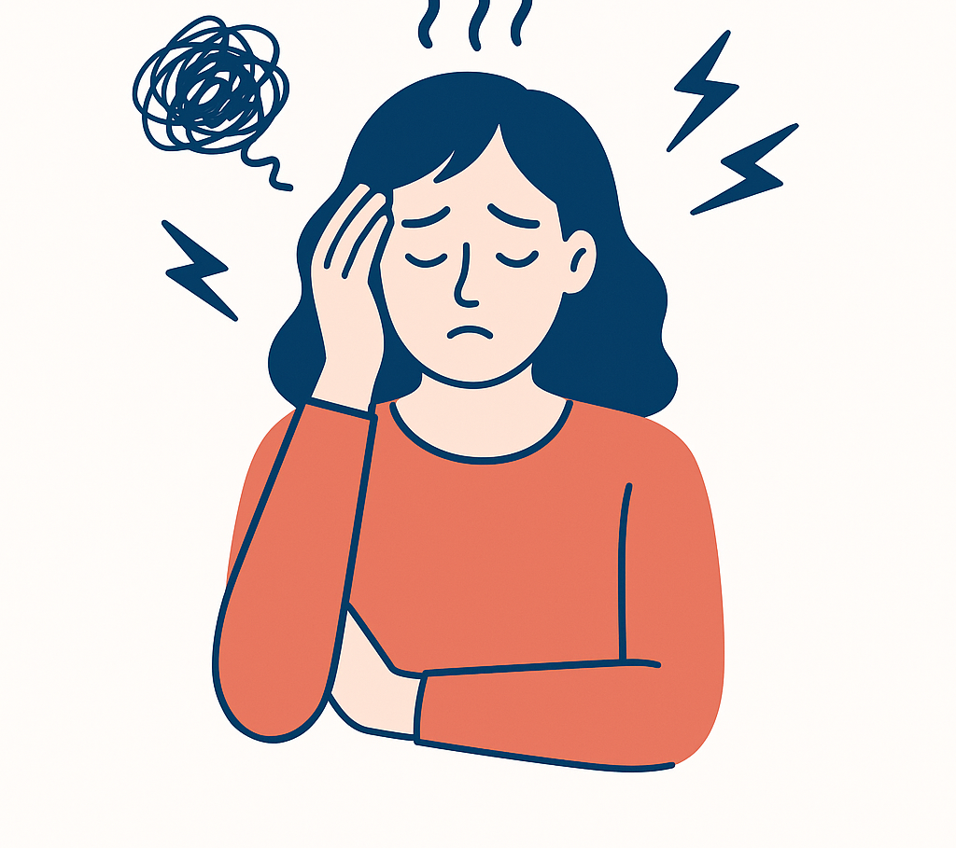
Weather Condition & Stress Levels
by İrem Çetiner
DSA210 Term Project
Instructor: Selim Balcısoy

Slide 2

Project Overview
This project investigates whether weather condition and temperature are statistically associated with daily stress levels. It combines hypothesis testing and machine learning to identify patterns and potential relationships between stress level and weather condition data, aiming to improve life quality.

Slide 3
Motivation
Stress is an unavoidable part of student life, especially during periods of intense academic pressure.
Having personally struggled with stress throughout my academic journey, I’ve often wondered whether external factors, like the weather condition or temperature, might influence how I feel. This project is a personal attempt to explore that possibility.
If a relationship exists between stress levels and weather-related conditions, uncovering it could be a step toward improving my daily routines and overall quality of life. By gaining insight into how external variables may affect my mood and mental state, I hope to make more informed choices that support my well-being.

Slide 4
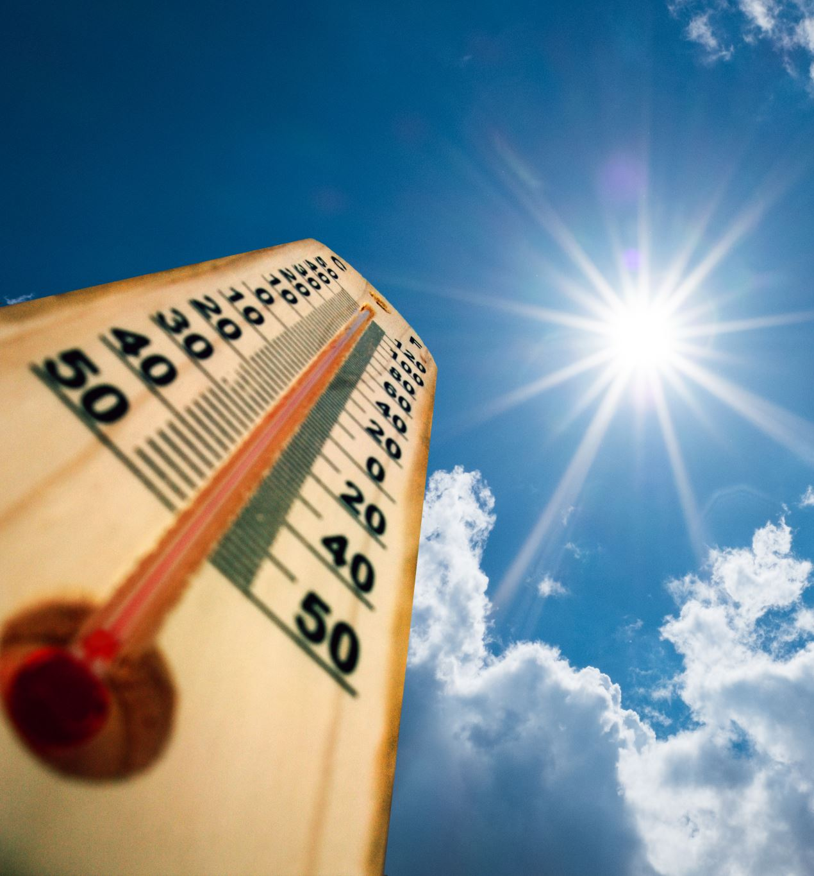
Dataset Overview
Temperature and Weather Condition: I will collect temperature and weather condition data from the Weather App of my Apple device.
Date and Time of the Day: The data of date and time of the day will be collected from my smartphone.
Stress Levels: I will track my stress levels in the morning, afternoon, evening and at night each day through my smart watch.

Slide 5
Hypothesis
Null Hypothesis (H₀): There is no significant relationship between temperature, weather condition and stress levels. Increase in temperature and improvement in weather condition do not significantly affect stress levels throughout the day.
Alternative Hypothesis (Hₐ): There is a significant relationship between weather condition alongside various factors and daily stress levels. As temperature increases and weather condition improves, daily stress levels decrease.

Slide 6

Visualization
Throughout the project, various visualization techniques were used to explore relationships within the data and to support hypothesis testing. The Python libraries Matplotlib and Seaborn were used to create bar charts, scatter plots, and boxplots.
Bar charts were used to observe the count of specific stress levels throughout the month.
Scatter plots helped to identify general patterns between variables.
Boxplots were specifically generated to visualize distribution of stress levels to a significant weather condition
These visual tools allowed for both general exploration and focused testing of key hypotheses.

Slide 7
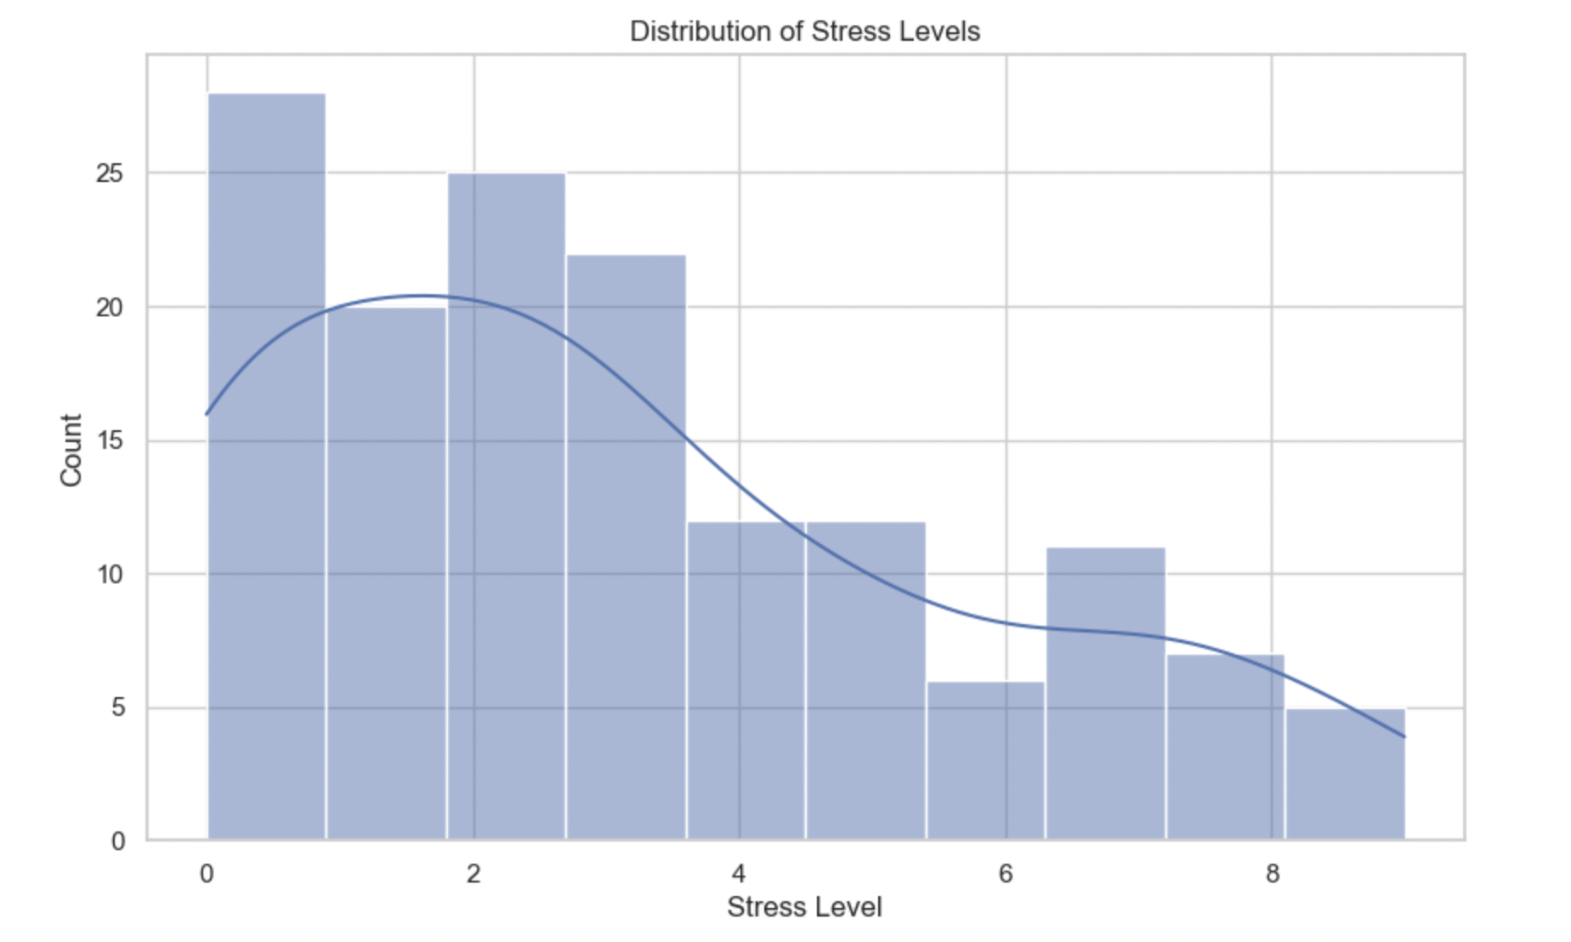
Univariate Analysis
The histogram is used to analyze the distribution of stress levels, providing insights into average daily stress levels.

Slide 8
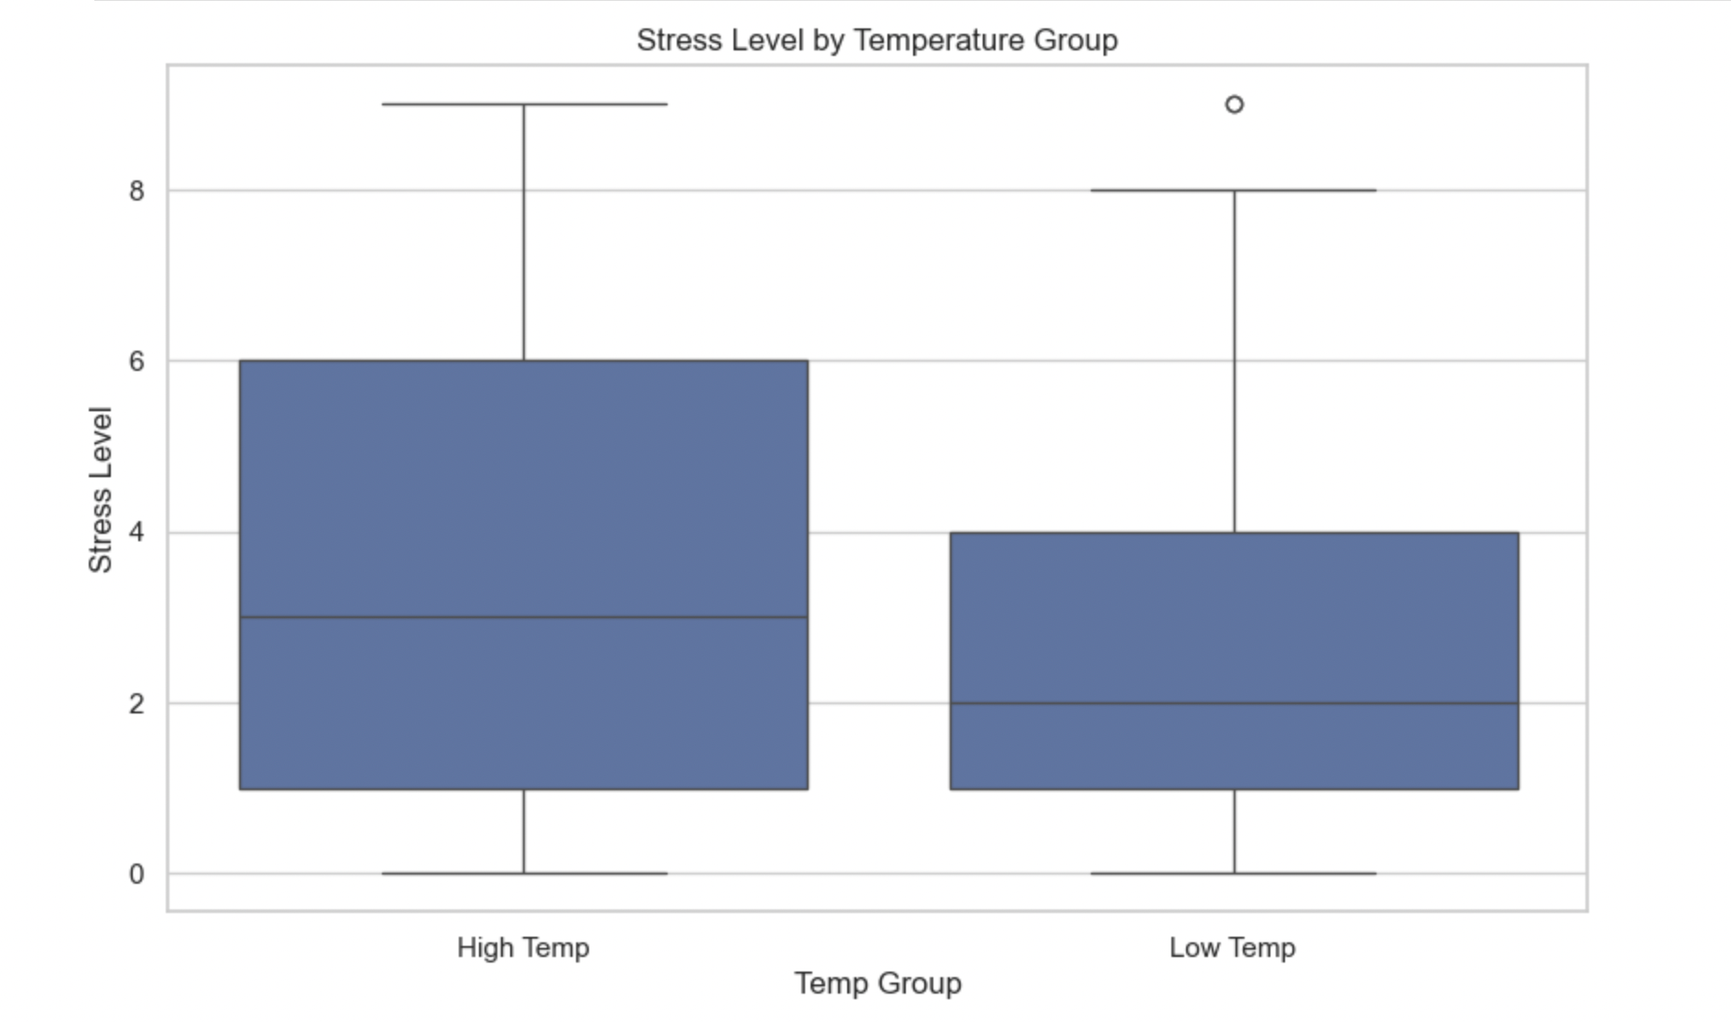
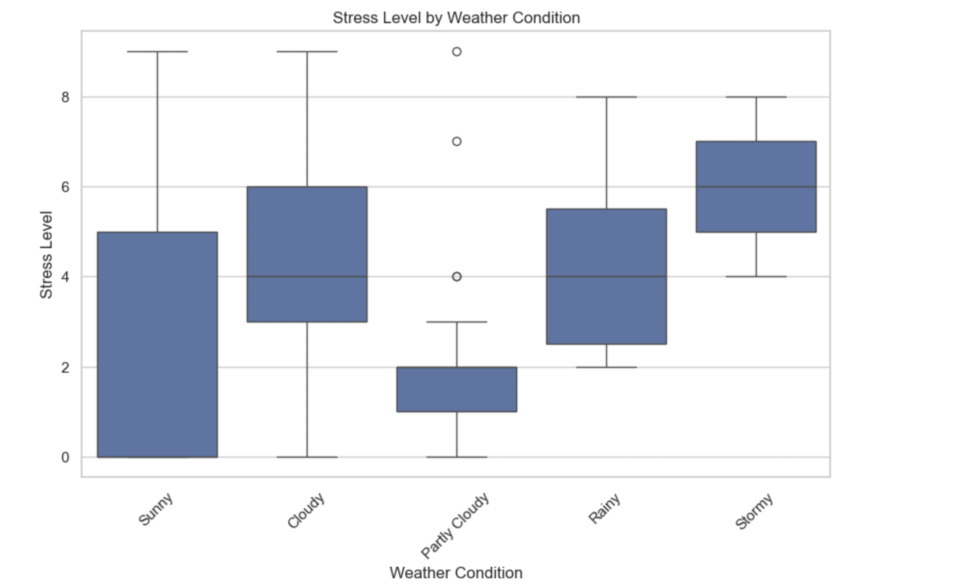
Bivariate Analysis
This boxplot shows that my stress levels are slightly higher when the temperature is high.
This boxplot shows that my stress levels tend to increase when the weather conditions are bad (cloudy, rainy, stormy).

Slide 9
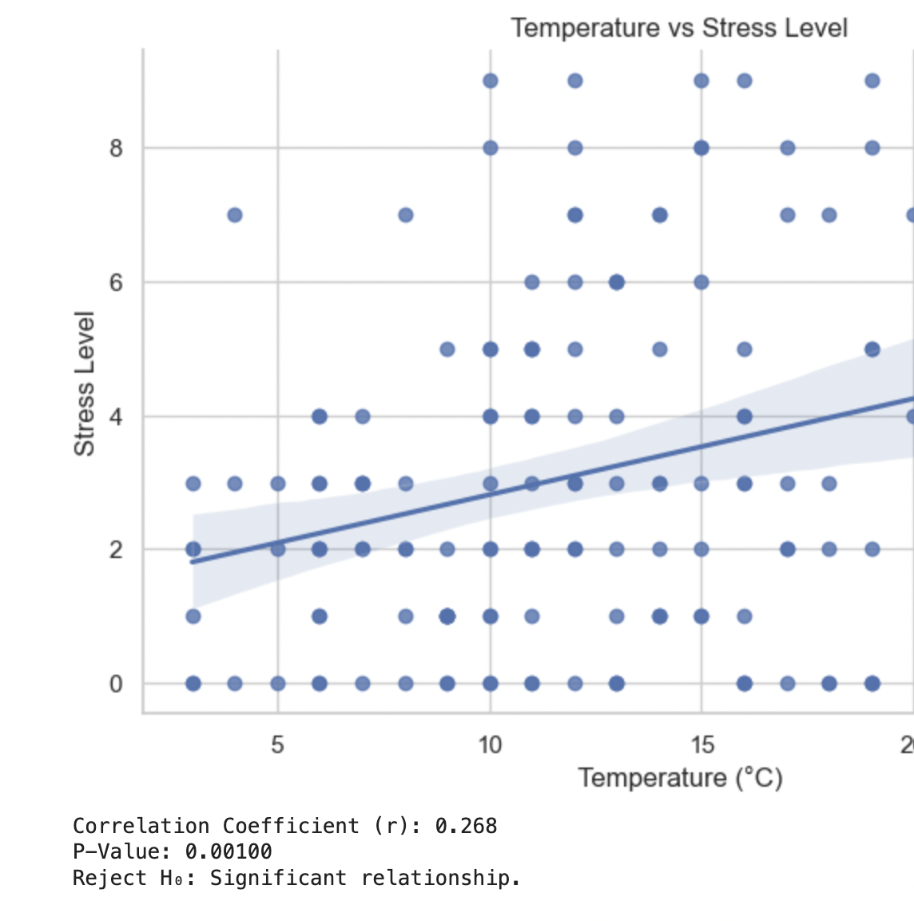
Hypothesis Testing Results
While the stress level result is statistically significant, the low correlation (0.26) contradicts initial assumptions.

Slide 10
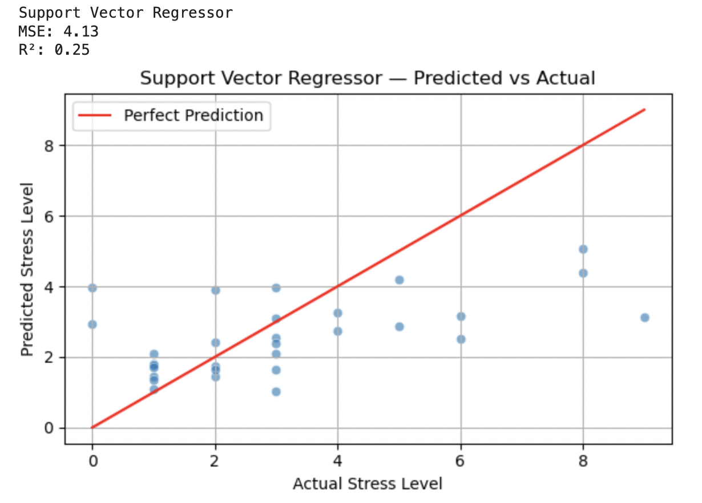
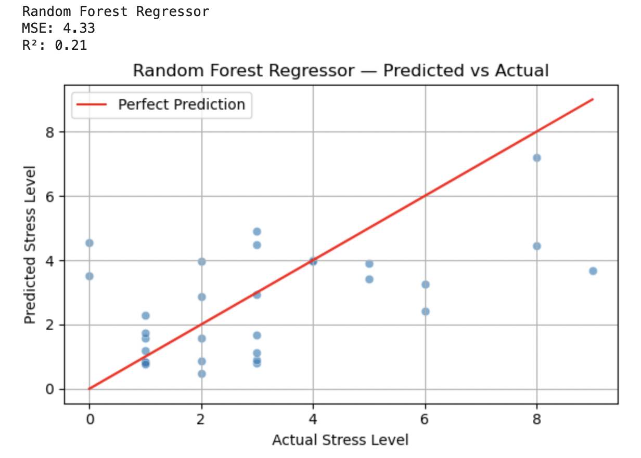
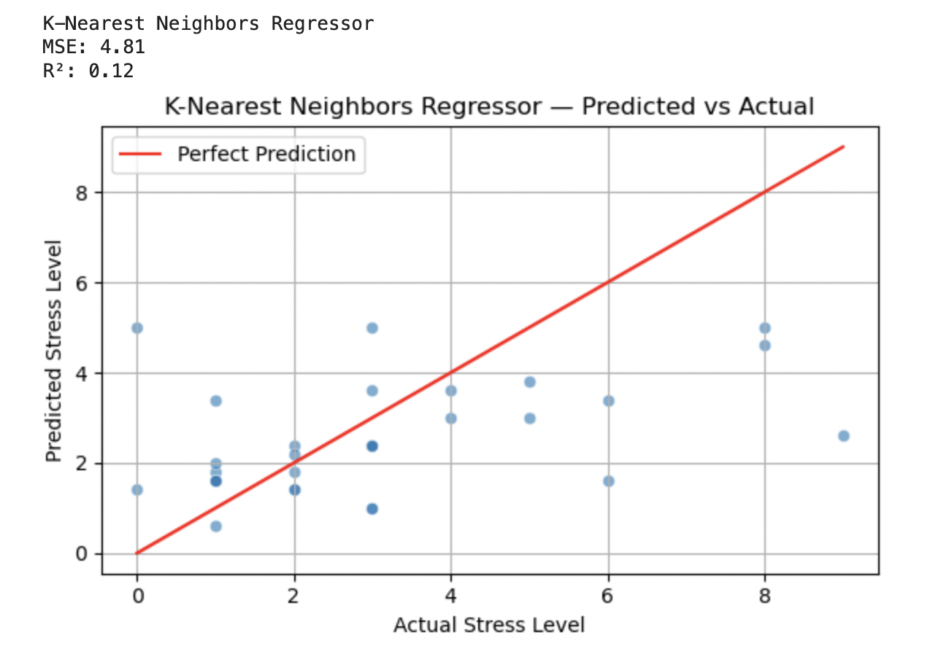
Regression Analysis
Support Vector Regressor performed the best among the models tested, but still yielded a relatively low R² score (~0.25), indicating that only about 25% of the variation in stress levels could be explained by the selected features.

Slide 11
Findings
The analysis revealed that weather conditions, temperature, time of day, and day of the week have only a modest impact on daily stress levels. Specifically:
Support Vector Regressor performed the best among the models tested, but still yielded a relatively low R² score (~0.25), indicating that only about 25% of the variation in stress levels could be explained by the selected features.
Both Random Forest Regressor and k-Nearest Neighbors models demonstrated even weaker predictive power, further confirming that these external environmental factors alone are not strong determinants of stress.
Despite the limited predictive strength, these findings show us that: While weather and timing may contribute minor fluctuations, they are not sufficient on their own to reliably predict stress levels.

Slide 12
Limitations
Small sample size: One month of data limits the model’s generalizability.
Sensor inaccuracy: Smartwatch-based stress measurements may contain noise.
Coarse weather data: Sudden environmental changes may have gone unrecorded.
Model limitations: Assumptions of ML models may not fully capture complex human behavior.

Slide 13
Future Work
Include behavioral data: Include variables like sleep quality, academic workload, or physical activity for a more comprehensive view of stress.
Expand data collection: Gather data over multiple months or seasons to capture long-term patterns and variability.
Improve stress measurement: Combine smartwatch data with self-reported stress levels for greater accuracy.

Slide 14

Conclusion
This project investigated whether weather conditions, temperature, time of day, and day of the week significantly affect stress levels. While the initial hypothesis assumed a meaningful relationship, the results showed only weak predictive power across all models (best R² ≈ 0.25).
Thus, we fail to reject the null hypothesis(H₀): There is no significant relationship between temperature, weather condition and stress levels. Increase in temperature and improvement in weather condition do not significantly affect stress levels throughout the day.

